Slide 1
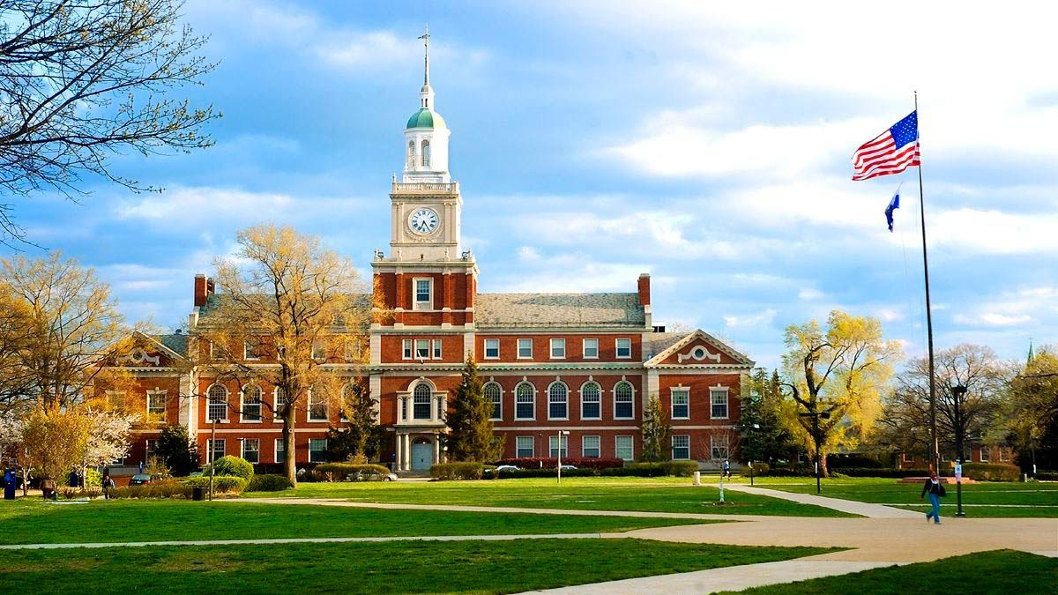
University Recommendation System
CSCI-5270-201 - Machine Learning
BY: AMIT MAHARJAN

Slide 2

Problem Statement
University application process can be daunting for international students
Identify best university for individual students based on their profiles.

Slide 3
Objectives
Develop a University Recommendation System using predictive analytics and supervised learning algorithms
Assist international students in identifying suitable universities for graduate studies in the United States based on their unique profiles and preferences
Reduce the time and financial resources invested by international students in applying to universities
Evaluate and compare the performance of various ML models in predicting university recommendations

Slide 4
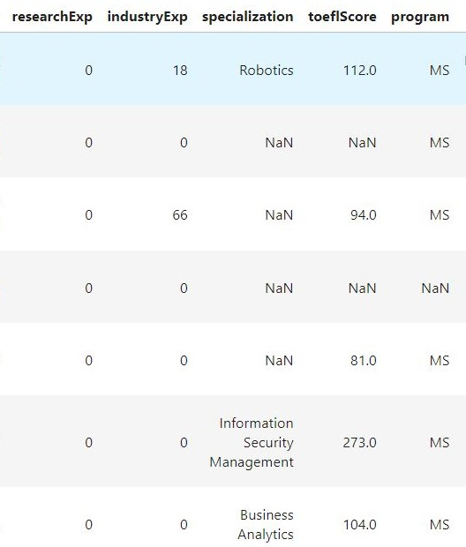
Dataset
Dataset extracted from Kaggle
Collected by Aditya Suresh Kumar
53,644 rows and 26 features
Features
GRE scores
TOEFL scores
Grade
Research experience
Journal publications
Well-balanced
27,955 Yes
25,689 No

Slide 5
Methodology
Data Preprocessing
Missing Values - Mean, Mode, KNN
Inconsistent Data – Major, GRE scores, GPA
Unnecessary Data
Normalization
Encoding Categorical Variables - One-hot encoding, Label encoding
Feature Engineering
Building and Training ML Models
Logistic Regression
Decision Tree
Random Forest
Support Vector Machine (SVM)
K Nearest Neighbors (KNN)
Naive Bayes
Testing the ML Models
Use 25% of data for testing
Cross-Validation
Identify the most suitable model

Slide 6
Expected Outcomes
Develop effective recommendation system
Improve decision making for international students
Evaluate Success of Model
Accuracy
Precision and Recall
F1 Score
Confusion Matrix
Challenges
Data Quality and Preprocessing
Model Complexity and Overfitting

Slide 7

Thank you !!

